Slide 1
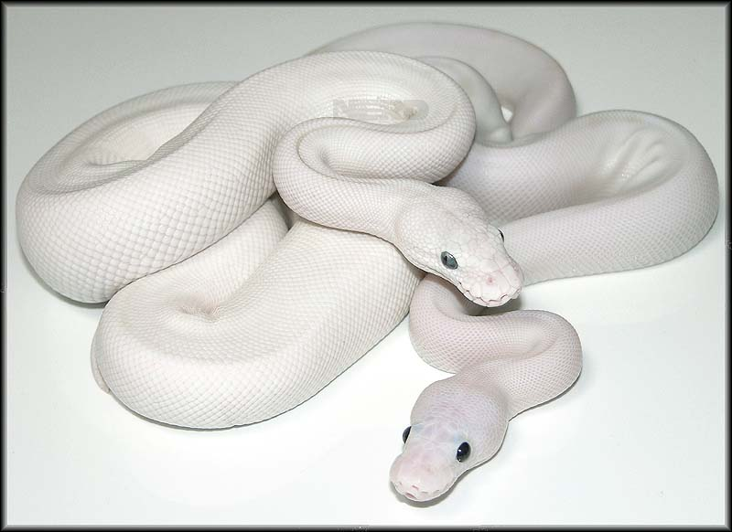
Multi-Level Debugging for Cython Mark Florisson

Slide 2
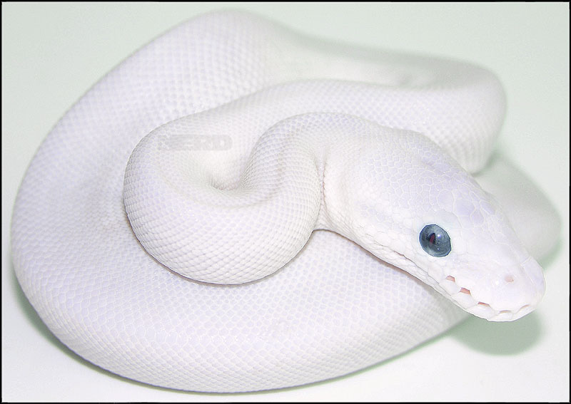
Cython Application
Python
Cython
C/C++

Slide 3
How to debug our application?
Language | Debugger
Python | pdb
C/C++, Fortan, Ada, Obj-C | gdb
Cython | ???
Problems?
No Cython Debugger
No multi-level debugger…

Slide 4

s/debugger/multi-level debugger/
Python
The Cython Debugger
Cython
C/C++

Slide 5
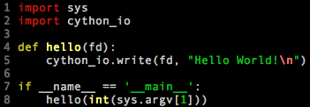
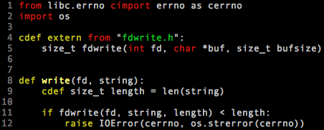
Show me some code!
Python: hello.py
Cython: cython_io.pyx

Slide 6
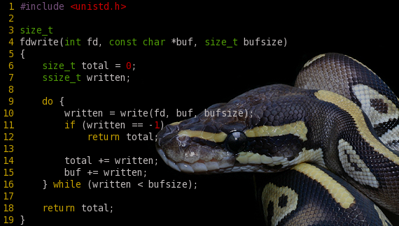
Don’t forget to link in the C code…
fdwrite.c

Slide 7



Build & Debug
Python: setup.py
Build

Slide 8
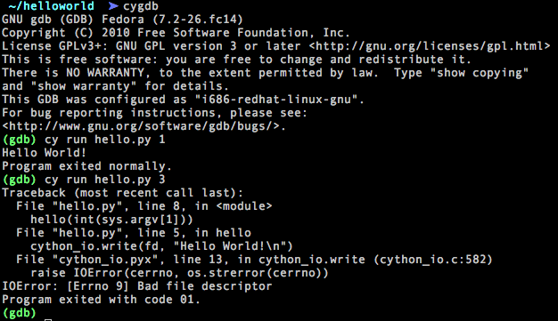
Running the Debugger

Slide 9
Feature List
Type | Command
Execution control | cy run cy cont cy step cy next cy finish
Symbolic debugging | cy break cy locals cy globals cy print cy set
Stack navigation | cy up cy down cy select
Source code listing | cy list
Backtrace formatting | cy bt
Code execution | cy exec

Slide 10
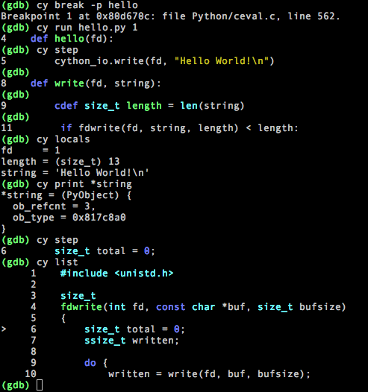
Notes:
Don’t have to change the command for Python/Cython/C

Slide 11
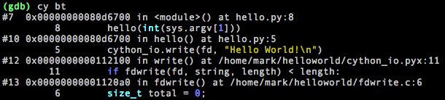
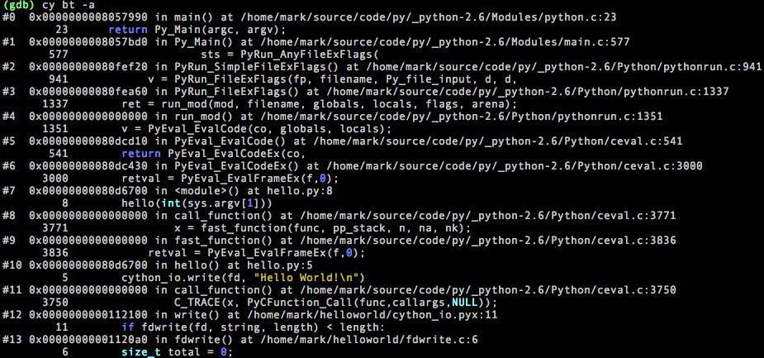
Backtraces

Slide 12
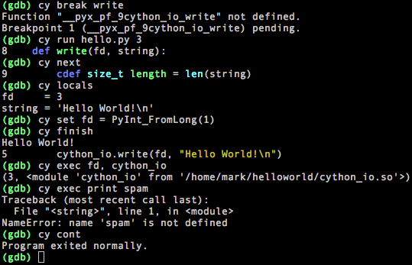
Code Execution & Data Modification

Slide 13
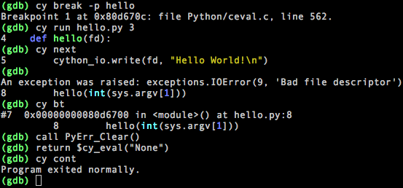
Exceptions & Control Flow
Notes:
REMOVE?

Slide 14
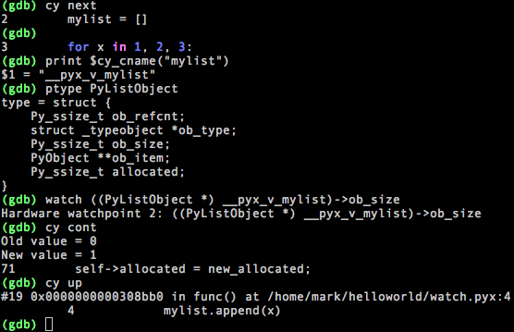
Watchpoints
Notes:
Conditional breakpoints?

Slide 15

GNU Debugger

Slide 16


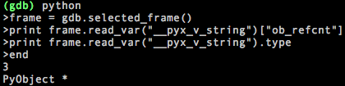
GDB Python API
GDB(Python)
GDB(Python(GDB))
Inspect the C stack
Inspect Values and Types
Pretty Printers

Slide 17
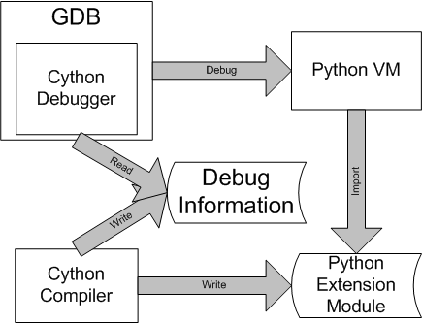
Implementation

Slide 18
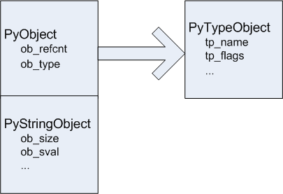
The Python Debugger
Extension of Tools/gdb/libpython.py
Written by David Malcolm
Additions: breakpoints, execution control, code execution
Debug information is dynamic

Slide 19
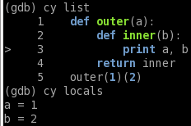

Cool stuff
GDB goodies
Conditional breakpoints (‘cond’)
Execute anything on breakpoint hit (‘commands’)
‘display’ a variable on every stop
Attach to a running process
Closure support
Entirely safe!
Compatible with Python 2 and 3
Pretty prints most builtin types
Add your own!

Slide 20
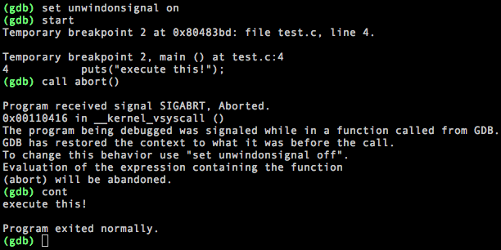
Final Notes
Access macros: -g3
Reference counting:
Py_IncRef/Py_DecRef
“unwind-on-signal”

Slide 21
More…
Conclusion
Coherent multi-language debugging
Powerful debugger
Easy & convenient
Part of Cython 0.14
Patch to Python 3.3
More details on docs.cython.org
GDB API: http://sourceware.org/gdb/onlinedocs/gdb/Python-API.html
PyCon 2011: talks by David Malcolm:
Dude, Where’s My RAM? A deep dive into how Python uses memory (http://blip.tv/file/4878749)
Using Python to debug C and C++ code (http://blip.tv/file/4877544?filename=Pycon-PyCon2011UsingPythonToDebugCAndCCodeUsingGdb402.m4v)
Future work…
Bringing debugger functionality to frontends
(Eclipse CDT, Emacs, Insight, DDD, etc)

